Slide 1
TOPIC 5
Decoder

Slide 2
CPU
Contents | Address
10111010 | 000
11110000 | 001
00111100 | 010
10010110 | 011
01100110 | 100
11100101 | 101
11100001 | 110
01100111 | 111

Slide 3
CPU
Contents | Address
10111010 | 000
11110000 | 001
00111100 | 010
10010110 | 011
01100110 | 100
11100101 | 101
11100001 | 110
01100111 | 111
A0
A1
A2
D0
D7

Slide 4
CPU
Contents | Address
10111010 | 000
11110000 | 001
00111100 | 010
10010110 | 011
01100110 | 100
11100101 | 101
11100001 | 110
01100111 | 111
A0
A1
A2
D0
D7

Slide 5
CPU
Contents | Address
10111010 | 000
11110000 | 001
00111100 | 010
10010110 | 011
01100110 | 100
11100101 | 101
11100001 | 110
01100111 | 111
A0
3 × 8
Decoder
A1
A2
D0
D7

Slide 6
CPU
Contents | Address
10111010 | 000
11110000 | 001
00111100 | 010
10010110 | 011
01100110 | 100
11100101 | 101
11100001 | 110
01100111 | 111
A0
3 × 8
Decoder
A1
A2
3-bit
address bus
D0
D7

Slide 7
CPU
Contents | Address
10111010 | 000
11110000 | 001
00111100 | 010
10010110 | 011
01100110 | 100
11100101 | 101
11100001 | 110
01100111 | 111
A0
3 × 8
Decoder
A1
A2
3-bit
address bus
D0
D7

Slide 8
CPU
Contents | Address
10111010 | 000
11110000 | 001
00111100 | 010
10010110 | 011
01100110 | 100
11100101 | 101
11100001 | 110
01100111 | 111
1
A0
3 × 8
Decoder
0
A1
1
A2
3-bit
address bus
D0
D7

Slide 9
CPU
Contents | Address
10111010 | 000
11110000 | 001
00111100 | 010
10010110 | 011
01100110 | 100
11100101 | 101
11100001 | 110
01100111 | 111
0
1
0
A0
3 × 8
Decoder
0
A1
0
1
A2
0
3-bit
address bus
0
1
D0
D7
0
0

Slide 10
CPU
Contents | Address
10111010 | 000
11110000 | 001
00111100 | 010
10010110 | 011
01100110 | 100
11100101 | 101
11100001 | 110
01100111 | 111
0
1
0
A0
3 × 8
Decoder
0
A1
0
1
A2
0
3-bit
address bus
0
1
D0
D7
0
8-bit data bus
0

Slide 11
CPU
Contents | Address
10111010 | 000
11110000 | 001
00111100 | 010
10010110 | 011
01100110 | 100
11100101 | 101
11100001 | 110
01100111 | 111
0
1
0
A0
3 × 8
Decoder
0
A1
0
1
A2
0
3-bit
address bus
0
1
D0
D7
0
8-bit data bus
0
11100101

Slide 12
CPU
Contents | Address
10111010 | 000
11110000 | 001
00111100 | 010
10010110 | 011
01100110 | 100
11100101 | 101
11100001 | 110
01100111 | 111
0
1
0
A0
3 × 8
Decoder
0
A1
0
1
A2
0
3-bit
address bus
0
1
D0
D7
0
8-bit data bus
0
Memory
11100101

Slide 13
CPU
Contents | Address
10111010 | 000
11110000 | 001
00111100 | 010
10010110 | 011
01100110 | 100
11100101 | 101
11100001 | 110
01100111 | 111
A0
3 × 8
Decoder
A1
A2
3-bit
address bus
D0
D7
8-bit data bus
Memory

Slide 14
CPU
Contents | Address
10111010 | 000
11110000 | 001
00111100 | 010
10010110 | 011
01100110 | 100
11100101 | 101
11100001 | 110
01100111 | 111
1
A0
3 × 8
Decoder
1
A1
0
A2
3-bit
address bus
D0
D7
8-bit data bus
Memory

Slide 15
CPU
Contents | Address
10111010 | 000
11110000 | 001
00111100 | 010
10010110 | 011
01100110 | 100
11100101 | 101
11100001 | 110
01100111 | 111
0
1
0
A0
3 × 8
Decoder
1
A1
0
0
A2
1
3-bit
address bus
0
0
D0
D7
0
8-bit data bus
0
Memory

Slide 16
CPU
Contents | Address
10111010 | 000
11110000 | 001
00111100 | 010
10010110 | 011
01100110 | 100
11100101 | 101
11100001 | 110
01100111 | 111
0
1
0
A0
3 × 8
Decoder
1
A1
0
0
A2
1
3-bit
address bus
0
0
D0
D7
0
8-bit data bus
0
10010110
Memory

Slide 17
CPU
Contents | Address
10111010 | 000
11110000 | 001
00111100 | 010
10010110 | 011
01100110 | 100
11100101 | 101
11100001 | 110
01100111 | 111
1
A0
3 × 8
Decoder
1
A1
1
A2
3-bit
address bus
D0
D7
8-bit data bus
Memory

Slide 18
CPU
Contents | Address
10111010 | 000
11110000 | 001
00111100 | 010
10010110 | 011
01100110 | 100
11100101 | 101
11100001 | 110
01100111 | 111
0
1
0
A0
3 × 8
Decoder
1
A1
0
1
A2
0
3-bit
address bus
0
0
D0
D7
0
8-bit data bus
1
Memory

Slide 19
CPU
Contents | Address
10111010 | 000
11110000 | 001
00111100 | 010
10010110 | 011
01100110 | 100
11100101 | 101
11100001 | 110
01100111 | 111
0
1
0
A0
3 × 8
Decoder
1
A1
0
1
A2
0
3-bit
address bus
0
0
D0
D7
0
8-bit data bus
1
Memory

Slide 20
CPU
Contents | Address
10111010 | 000
11110000 | 001
00111100 | 010
10010110 | 011
01100110 | 100
11100101 | 101
11100001 | 110
01100111 | 111
0
1
0
A0
3 × 8
Decoder
1
A1
0
1
A2
0
3-bit
address bus
0
0
D0
D7
0
8-bit data bus
1
01100111
Memory

Slide 21
3 × 8
Decoder
D0
D1
z
D2
y
D3
x
D4
D5
D6
D7

Slide 22
3 × 8
Decoder
D0
D1
z
D2
y
D3
x
D4
D5
D6
D7
A 3-to-8 decoder
  3 input variables; up to 2³ output lines
  only one output can be active (high) at any time

Slide 23
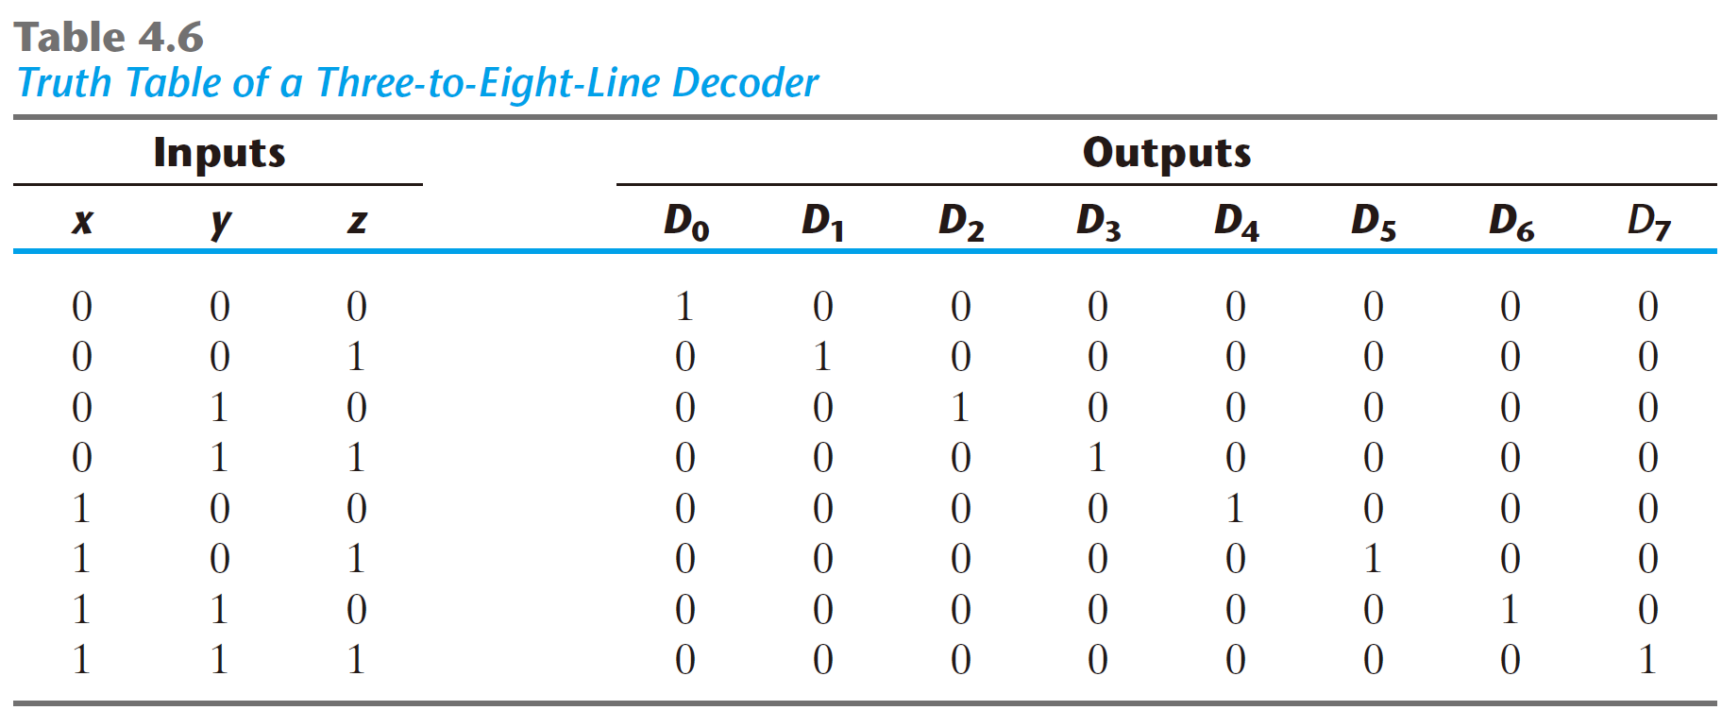
3 × 8
Decoder
D0
D1
z
D2
y
D3
x
D4
D5
D6
D7

Slide 24
D0 = x’y’z’
D0
3 × 8
Decoder
D1
z
D2
y
D3
x
D4
D5
D6
D7

Slide 25
D0 = x’y’z’
D0
3 × 8
Decoder
D1
D1 = x’y’z
z
D2
y
D3
x
D4
D5
D6
D7

Slide 26
D0 = x’y’z’
D0
3 × 8
Decoder
D1
D1 = x’y’z
z
D2
y
D3
x
D4
D2 = x’yz’
D5
D6
D7

Slide 27
D0 = x’y’z’
D3 = x’yz
D0
3 × 8
Decoder
D1
D1 = x’y’z
z
D2
y
D3
x
D4
D2 = x’yz’
D5
D6
D7

Slide 28
D0 = x’y’z’
D3 = x’yz
D0
3 × 8
Decoder
D1
D1 = x’y’z
z
D2
D4 = xy’z’
D3
y
D4
x
D5
D2 = x’yz’
D6
D7

Slide 29
D0 = x’y’z’
D3 = x’yz
D0
3 × 8
Decoder
D1
D1 = x’y’z
z
D2
D4 = xy’z’
D3
y
D4
x
D5
D2 = x’yz’
D5 = xy’z
D6
D7

Slide 30
D0 = x’y’z’
D3 = x’yz
D6 = xyz’
D0
3 × 8
Decoder
D1
D1 = x’y’z
z
D2
D4 = xy’z’
D3
y
D4
x
D5
D2 = x’yz’
D5 = xy’z
D6
D7

Slide 31
D0 = x’y’z’
D3 = x’yz
D6 = xyz’
D0
3 × 8
Decoder
D1
D1 = x’y’z
z
D2
D4 = xy’z’
D7 = xyz
D3
y
D4
x
D5
D2 = x’yz’
D5 = xy’z
D6
D7

Slide 32
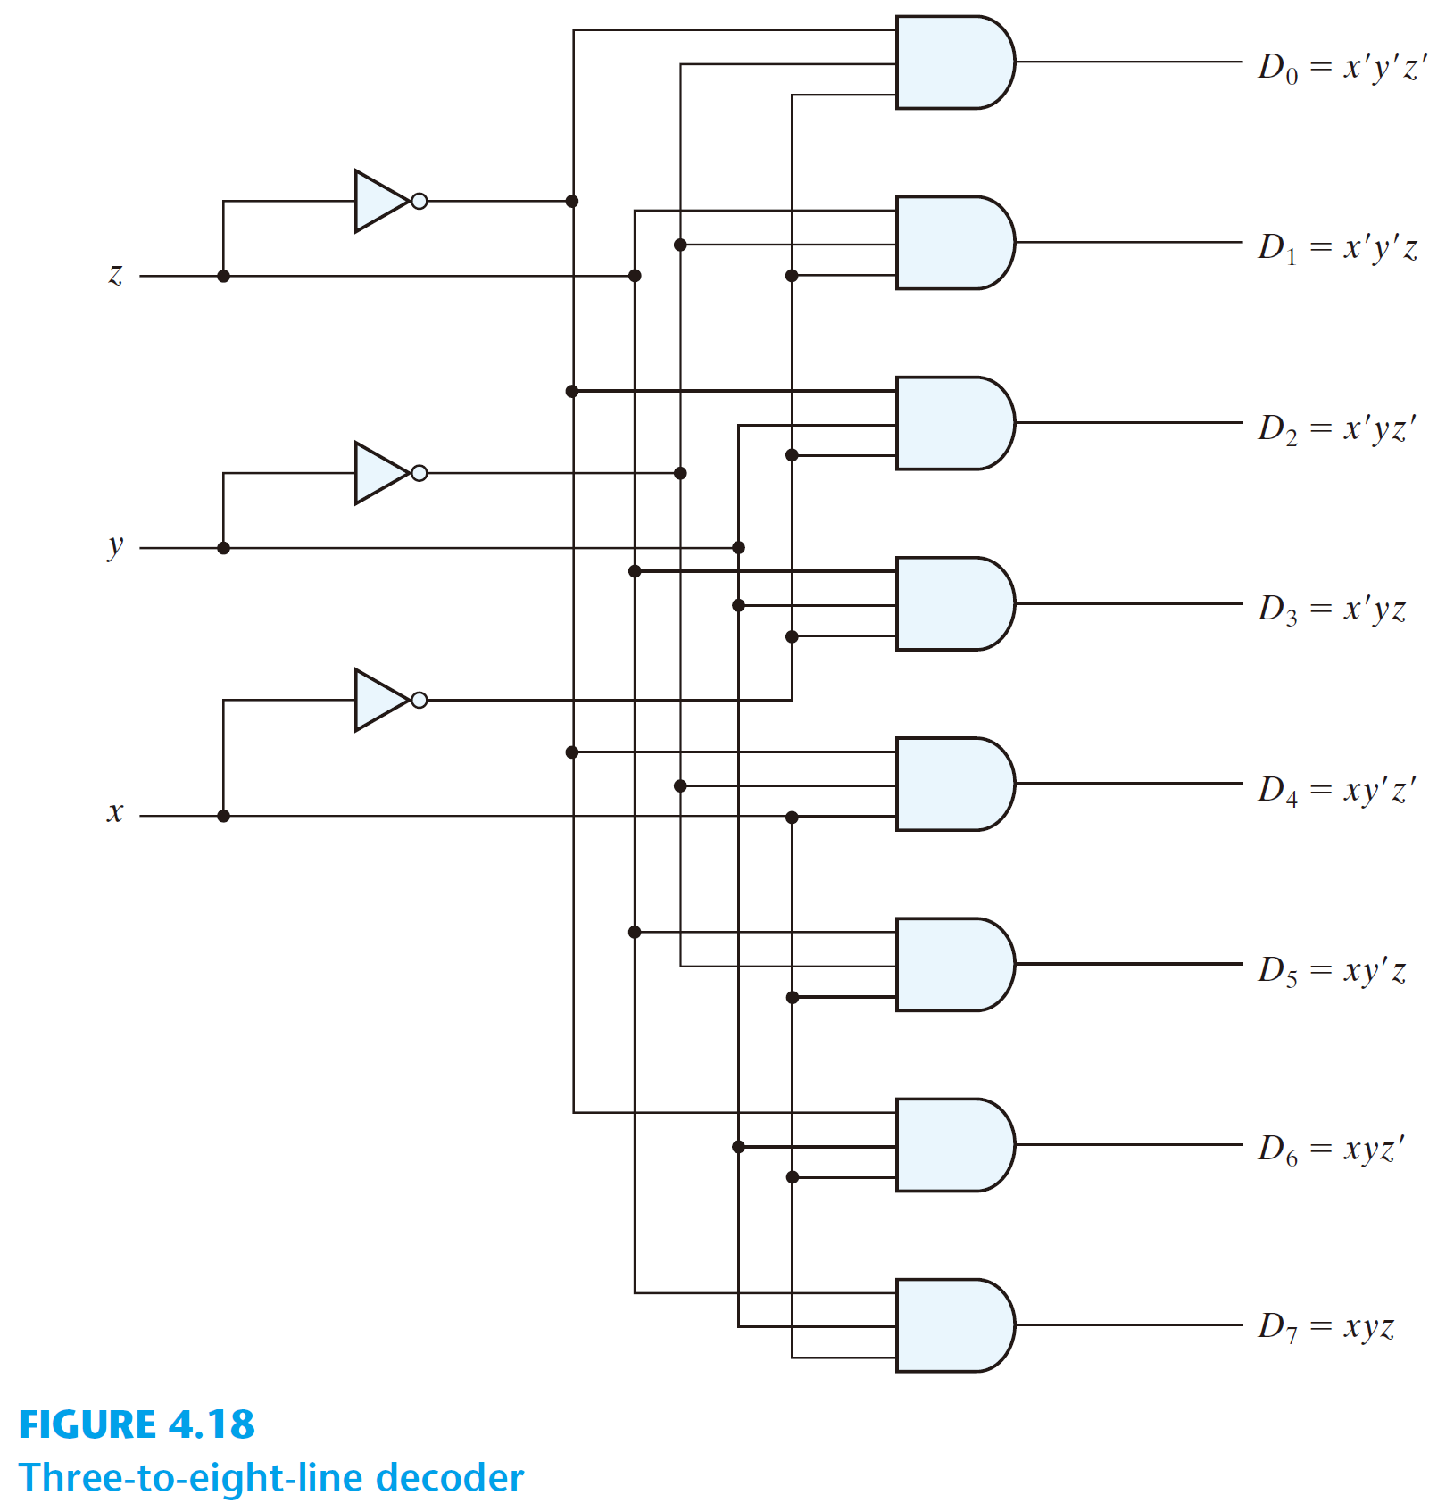

Slide 33
Combinational logic implementation
  each output = a minterm
  use a decoder and an external OR gate to implement any Boolean function of n input variables

Slide 34
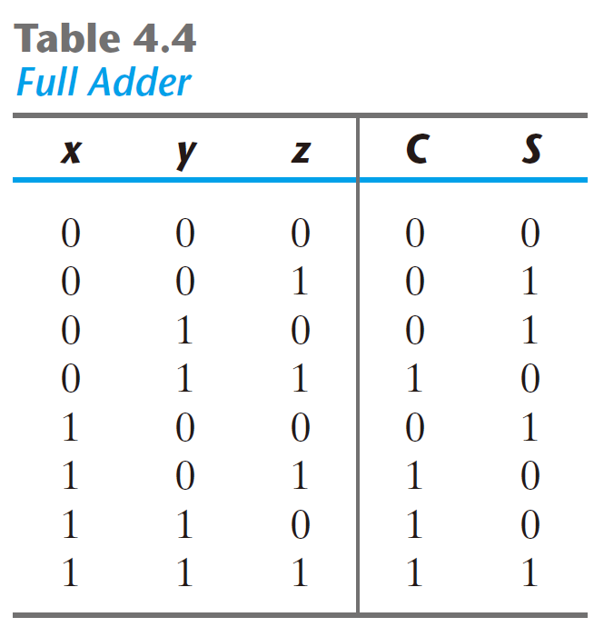
Full-Adder
    S(x, y, x) = ∑(1, 2, 4, 7)
    C(x, y, z) = ∑(3, 5, 6, 7)

Slide 35
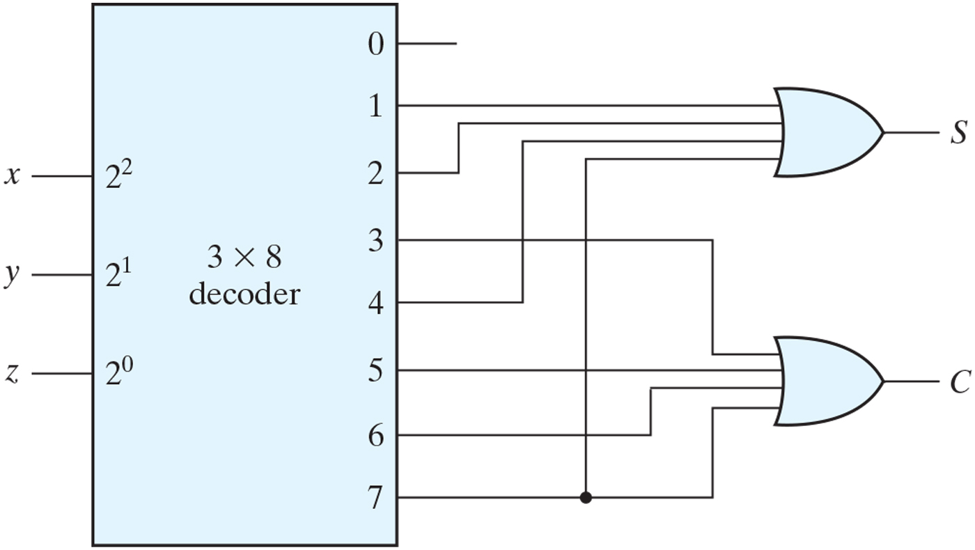
    S(x, y, x) = ∑(1, 2, 4, 7)
    C(x, y, z) = ∑(3, 5, 6, 7)

Slide 36
D0
D1
D2
D3
D4
D5
    S(x, y, x) = ∑(1, 2, 4, 7)
    C(x, y, z) = ∑(3, 5, 6, 7)
D6
D7

Slide 37
D0
D1
D2
D3
D4
D5
    S(x, y, x) = ∑(1, 2, 4, 7)
    C(x, y, z) = ∑(3, 5, 6, 7)
D6
D7

Slide 38
D0
D1
D2
D3
D4
D5
    S(x, y, x) = ∑(1, 2, 4, 7)
    C(x, y, z) = ∑(3, 5, 6, 7)
D6
D7

Slide 39
D0
D1
D2
D3
D4
D5
    S(x, y, x) = ∑(1, 2, 4, 7)
    C(x, y, z) = ∑(3, 5, 6, 7)
D6
D7

Slide 40
D0
D1
D2
D3
D4
D5
    S(x, y, x) = ∑(1, 2, 4, 7)
    C(x, y, z) = ∑(3, 5, 6, 7)
D6
D7

Slide 42
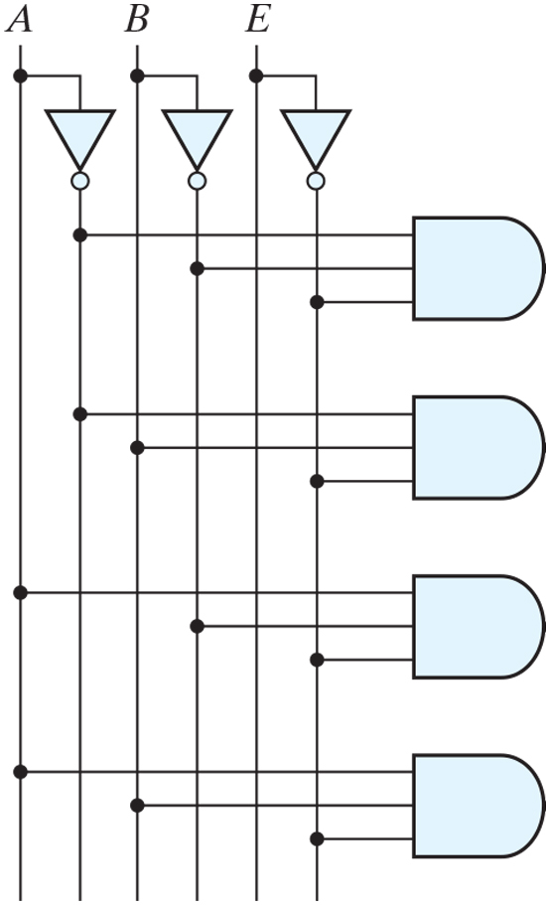
  A decoder with an enable input
D0
E | A | B | D0 | D1 | D2 | D3
0 | X | X | 0 | 0 | 0 | 0
1 | 0 | 0 | 1 | 0 | 0 | 0
1 | 0 | 1 | 0 | 1 | 0 | 0
1 | 1 | 0 | 0 | 0 | 1 | 0
1 | 1 | 1 | 0 | 0 | 0 | 1
D1
D2
D3

Slide 43
  A decoder with an enable input
0
0
D0
E | A | B | D0 | D1 | D2 | D3
0 | X | X | 0 | 0 | 0 | 0
1 | 0 | 0 | 1 | 0 | 0 | 0
1 | 0 | 1 | 0 | 1 | 0 | 0
1 | 1 | 0 | 0 | 0 | 1 | 0
1 | 1 | 1 | 0 | 0 | 0 | 1
D1
0
0
D2
0
D3

Slide 44
  A decoder with an enable input
0
0
1
1
D0
E | A | B | D0 | D1 | D2 | D3
0 | X | X | 0 | 0 | 0 | 0
1 | 0 | 0 | 1 | 0 | 0 | 0
1 | 0 | 1 | 0 | 1 | 0 | 0
1 | 1 | 0 | 0 | 0 | 1 | 0
1 | 1 | 1 | 0 | 0 | 0 | 1
D1
0
0
D2
0
D3

Slide 45
  A decoder with an enable input
0
1
1
0
D0
E | A | B | D0 | D1 | D2 | D3
0 | X | X | 0 | 0 | 0 | 0
1 | 0 | 0 | 1 | 0 | 0 | 0
1 | 0 | 1 | 0 | 1 | 0 | 0
1 | 1 | 0 | 0 | 0 | 1 | 0
1 | 1 | 1 | 0 | 0 | 0 | 1
D1
1
0
D2
0
D3

Slide 46
  A decoder with an enable input
1
0
1
0
D0
E | A | B | D0 | D1 | D2 | D3
0 | X | X | 0 | 0 | 0 | 0
1 | 0 | 0 | 1 | 0 | 0 | 0
1 | 0 | 1 | 0 | 1 | 0 | 0
1 | 1 | 0 | 0 | 0 | 1 | 0
1 | 1 | 1 | 0 | 0 | 0 | 1
D1
0
1
D2
0
D3

Slide 47
  A decoder with an enable input
1
1
1
0
D0
E | A | B | D0 | D1 | D2 | D3
0 | X | X | 0 | 0 | 0 | 0
1 | 0 | 0 | 1 | 0 | 0 | 0
1 | 0 | 1 | 0 | 1 | 0 | 0
1 | 1 | 0 | 0 | 0 | 1 | 0
1 | 1 | 1 | 0 | 0 | 0 | 1
D1
0
0
D2
1
D3

Slide 48
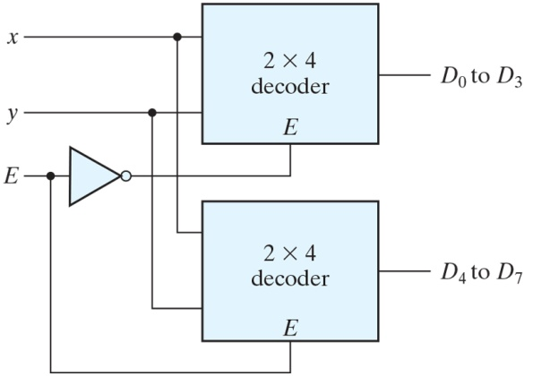
  Two 2-to-4 decoder: a 3-to-8 deocder

Slide 49
  Two 2-to-4 decoder: a 3-to-8 deocder
E | x | y | D0 | D1 | D2 | D3 | D4 | D5 | D6 | D7
0 | 0 | 0 | 1 | 0 | 0 | 0 | 0 | 0 | 0 | 0
0 | 0 | 1 | 0 | 1 | 0 | 0 | 0 | 0 | 0 | 0
0 | 1 | 0 | 0 | 0 | 1 | 0 | 0 | 0 | 0 | 0
0 | 1 | 1 | 0 | 0 | 0 | 1 | 0 | 0 | 0 | 0
1 | 0 | 0 | 0 | 0 | 0 | 0 | 1 | 0 | 0 | 0
1 | 0 | 1 | 0 | 0 | 0 | 0 | 0 | 1 | 0 | 0
1 | 1 | 0 | 0 | 0 | 0 | 0 | 0 | 0 | 1 | 0
1 | 1 | 1 | 0 | 0 | 0 | 0 | 0 | 0 | 0 | 1

Slide 50
  Two 2-to-4 decoder: a 3-to-8 deocder
E | x | y | D0 | D1 | D2 | D3 | D4 | D5 | D6 | D7
0 | 0 | 0 | 1 | 0 | 0 | 0 | 0 | 0 | 0 | 0
0 | 0 | 1 | 0 | 1 | 0 | 0 | 0 | 0 | 0 | 0
0 | 1 | 0 | 0 | 0 | 1 | 0 | 0 | 0 | 0 | 0
0 | 1 | 1 | 0 | 0 | 0 | 1 | 0 | 0 | 0 | 0
1 | 0 | 0 | 0 | 0 | 0 | 0 | 1 | 0 | 0 | 0
1 | 0 | 1 | 0 | 0 | 0 | 0 | 0 | 1 | 0 | 0
1 | 1 | 0 | 0 | 0 | 0 | 0 | 0 | 0 | 1 | 0
1 | 1 | 1 | 0 | 0 | 0 | 0 | 0 | 0 | 0 | 1
0
1
0

Slide 51
  Two 2-to-4 decoder: a 3-to-8 deocder
E | x | y | D0 | D1 | D2 | D3 | D4 | D5 | D6 | D7
0 | 0 | 0 | 1 | 0 | 0 | 0 | 0 | 0 | 0 | 0
0 | 0 | 1 | 0 | 1 | 0 | 0 | 0 | 0 | 0 | 0
0 | 1 | 0 | 0 | 0 | 1 | 0 | 0 | 0 | 0 | 0
0 | 1 | 1 | 0 | 0 | 0 | 1 | 0 | 0 | 0 | 0
1 | 0 | 0 | 0 | 0 | 0 | 0 | 1 | 0 | 0 | 0
1 | 0 | 1 | 0 | 0 | 0 | 0 | 0 | 1 | 0 | 0
1 | 1 | 0 | 0 | 0 | 0 | 0 | 0 | 0 | 1 | 0
1 | 1 | 1 | 0 | 0 | 0 | 0 | 0 | 0 | 0 | 1
1
0
1

Slide 52
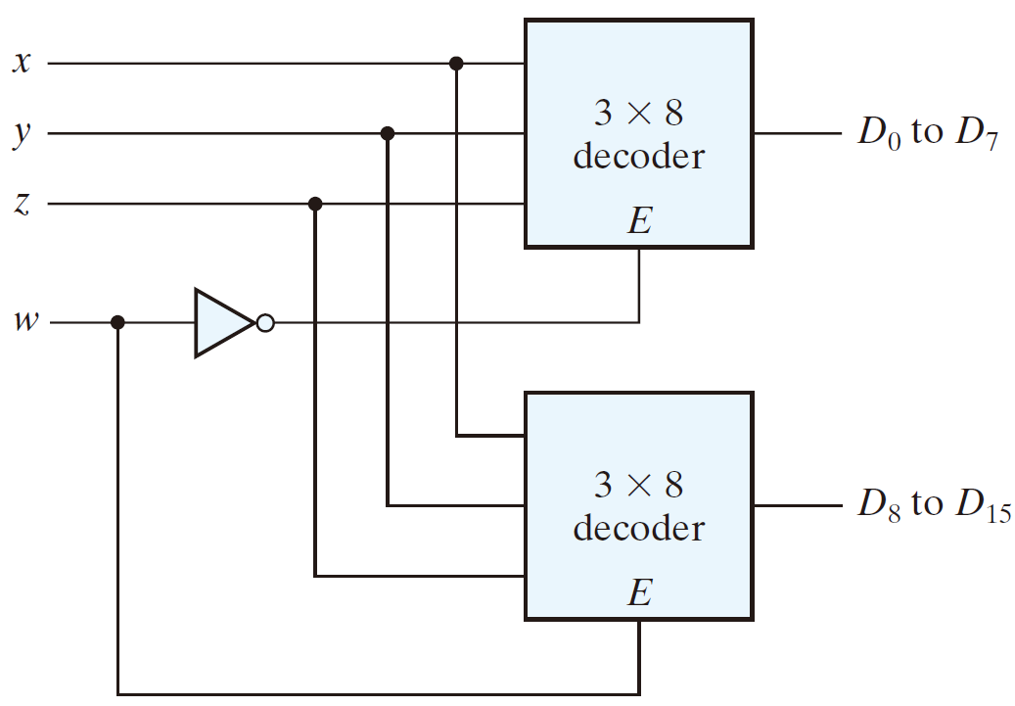
  Two 3-to-8 decoder: a 4-to-16 deocder

Slide 53
TOPIC 6
Multiplexer

Slide 54
Operation
CarryIn
a
AND
OR
ADD
0
1
2
Result
+
Function | CarryIn | Op1 | Op0
and | X | 0 | 0
or | X | 0 | 1
add | 0 | 1 | 0
b
CarryOut

Slide 55
Operation
CarryIn
a
AND
OR
ADD
0
1
2
Result
+
Function | CarryIn | Op1 | Op0
and | X | 0 | 0
or | X | 0 | 1
add | 0 | 1 | 0
b
CarryOut

Slide 56
Operation
CarryIn
a
AND
OR
ADD
0
1
2
Result
+
Function | CarryIn | Op1 | Op0
and | X | 0 | 0
or | X | 0 | 1
add | 0 | 1 | 0
b
CarryOut

Slide 57
Operation
CarryIn
a
AND
OR
ADD
0
1
2
Result
+
Function | CarryIn | Op1 | Op0
and | X | 0 | 0
or | X | 0 | 1
add | 0 | 1 | 0
b
CarryOut

Slide 58
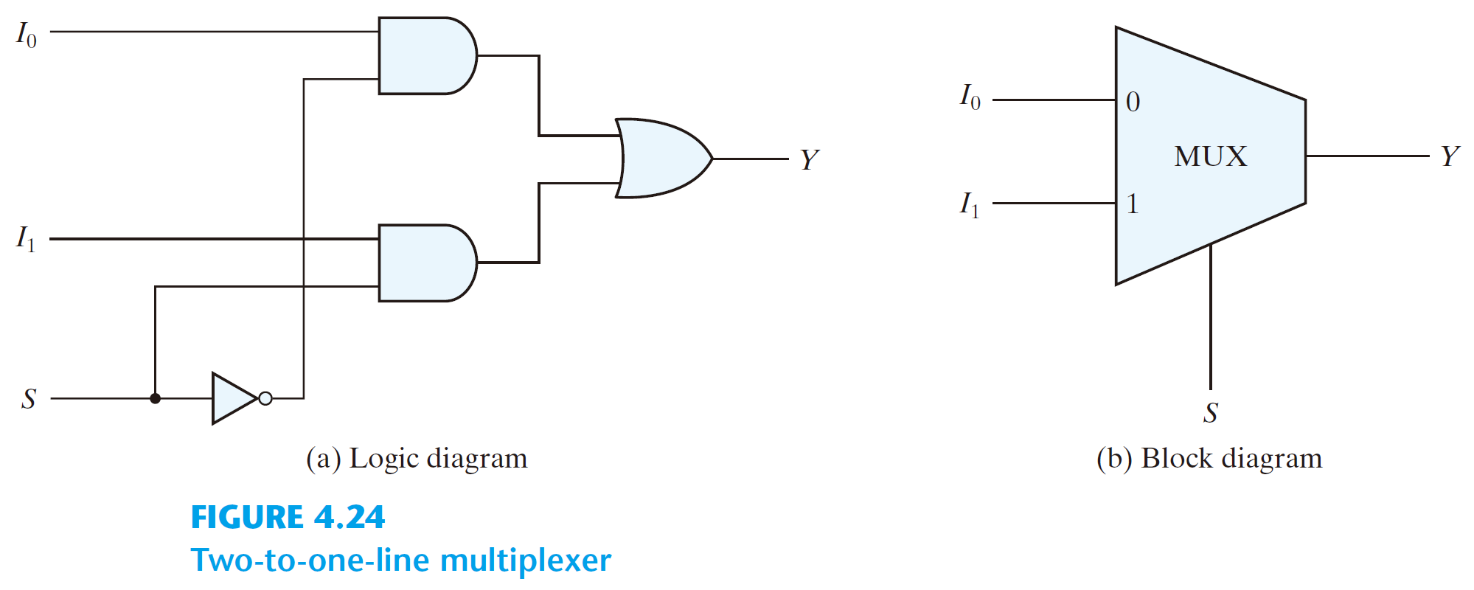
Multiplexers
  select binary information from one of many input lines and direct it to a single output line.
  2^{n} input lines, n selection lines and one output line
  e.g.: 2-to-1-line multiplexer

Slide 60
S | I₀ | I₁ | Y
0 | 0 | 0 | 0
0 | 0 | 1 | 0
0 | 1 | 0 | 1
0 | 1 | 1 | 1
1 | 0 | 0 | 0
1 | 0 | 1 | 1
1 | 1 | 0 | 0
1 | 1 | 1 | 1

Slide 61
I₀I₁
 | 00 | 01 | 11 | 10
0 |  |  | 1 | 1
1 |  | 1 | 1
S
S | I₀ | I₁ | Y
0 | 0 | 0 | 0
0 | 0 | 1 | 0
0 | 1 | 0 | 1
0 | 1 | 1 | 1
1 | 0 | 0 | 0
1 | 0 | 1 | 1
1 | 1 | 0 | 0
1 | 1 | 1 | 1

Slide 62
I₀I₁
 | 00 | 01 | 11 | 10
0 |  |  | 1 | 1
1 |  | 1 | 1
S
S | I₀ | I₁ | Y
0 | 0 | 0 | 0
0 | 0 | 1 | 0
0 | 1 | 0 | 1
0 | 1 | 1 | 1
1 | 0 | 0 | 0
1 | 0 | 1 | 1
1 | 1 | 0 | 0
1 | 1 | 1 | 1

Slide 63
I₀I₁
 | 00 | 01 | 11 | 10
0 |  |  | 1 | 1
1 |  | 1 | 1
S
Y = S’ · I₀ + S · I₁
S | I₀ | I₁ | Y
0 | 0 | 0 | 0
0 | 0 | 1 | 0
0 | 1 | 0 | 1
0 | 1 | 1 | 1
1 | 0 | 0 | 0
1 | 0 | 1 | 1
1 | 1 | 0 | 0
1 | 1 | 1 | 1

Slide 64
I₀I₁
 | 00 | 01 | 11 | 10
0 |  |  | 1 | 1
1 |  | 1 | 1
S
Y = S’ · I₀ + S · I₁
S | I₀ | I₁ | Y
0 | 0 | 0 | 0
0 | 0 | 1 | 0
0 | 1 | 0 | 1
0 | 1 | 1 | 1
1 | 0 | 0 | 0
1 | 0 | 1 | 1
1 | 1 | 0 | 0
1 | 1 | 1 | 1

Slide 65
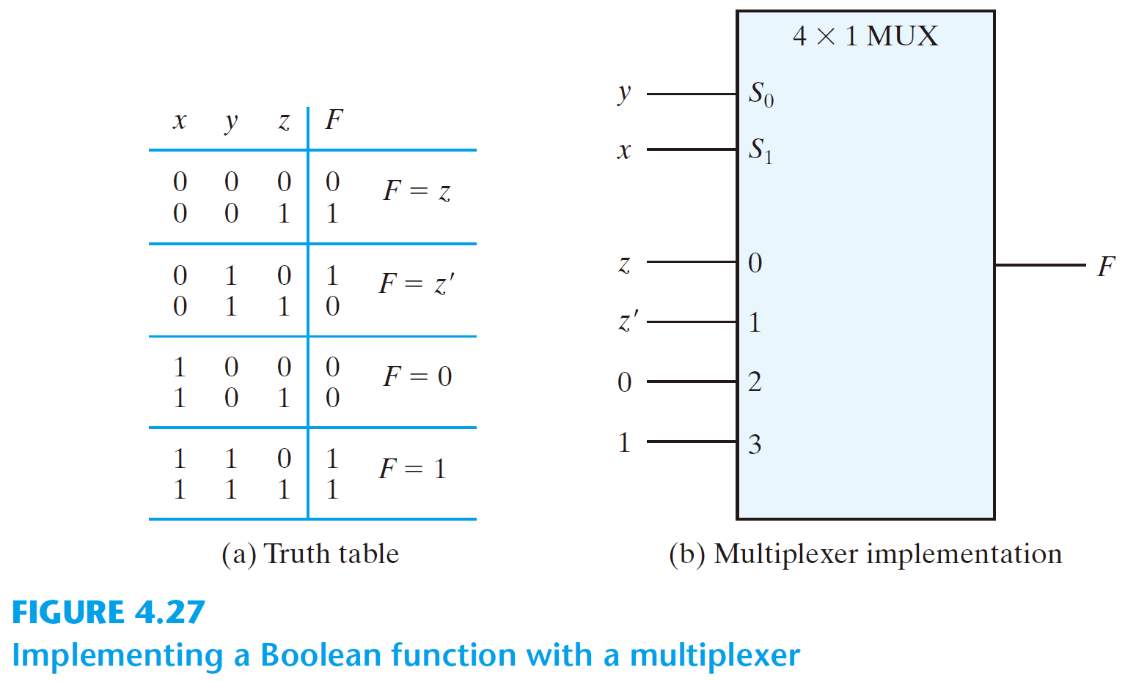
  4-to-1-line multiplexer
I₀
Y
I₁
I₂
I₃

Slide 66
S | I₀ | I₁ | Y
0 | 0 | 0 | 0
0 | 0 | 1 | 0
0 | 1 | 0 | 1
0 | 1 | 1 | 1
1 | 0 | 0 | 0
1 | 0 | 1 | 1
1 | 1 | 0 | 0
1 | 1 | 1 | 1

Slide 67
S | I₀ | I₁ | Y
0 | 0 | 0 | 0
0 | 0 | 1 | 0
0 | 1 | 0 | 1
0 | 1 | 1 | 1
1 | 0 | 0 | 0
1 | 0 | 1 | 1
1 | 1 | 0 | 0
1 | 1 | 1 | 1
S | Y
0 | I₀
1 | I₁

Slide 68
Y = S’ · I₀ + S · I₁
S | I₀ | I₁ | Y
0 | 0 | 0 | 0
0 | 0 | 1 | 0
0 | 1 | 0 | 1
0 | 1 | 1 | 1
1 | 0 | 0 | 0
1 | 0 | 1 | 1
1 | 1 | 0 | 0
1 | 1 | 1 | 1
S | Y
0 | I₀
1 | I₁

Slide 69
Y = S’ · I₀ + S · I₁
S | I₀ | I₁ | Y
0 | 0 | 0 | 0
0 | 0 | 1 | 0
0 | 1 | 0 | 1
0 | 1 | 1 | 1
1 | 0 | 0 | 0
1 | 0 | 1 | 1
1 | 1 | 0 | 0
1 | 1 | 1 | 1
S | Y
0 | I₀
1 | I₁

Slide 70
Y = 0’ · I₀ + 0 · I₁ = I₀
S | I₀ | I₁ | Y
0 | 0 | 0 | 0
0 | 0 | 1 | 0
0 | 1 | 0 | 1
0 | 1 | 1 | 1
1 | 0 | 0 | 0
1 | 0 | 1 | 1
1 | 1 | 0 | 0
1 | 1 | 1 | 1
S | Y
0 | I₀
1 | I₁

Slide 71
Y = S’ · I₀ + S · I₁
S | I₀ | I₁ | Y
0 | 0 | 0 | 0
0 | 0 | 1 | 0
0 | 1 | 0 | 1
0 | 1 | 1 | 1
1 | 0 | 0 | 0
1 | 0 | 1 | 1
1 | 1 | 0 | 0
1 | 1 | 1 | 1
S | Y
0 | I₀
1 | I₁

Slide 72
Y = 1’ · I₀ + 1 · I₁ = I₁
S | I₀ | I₁ | Y
0 | 0 | 0 | 0
0 | 0 | 1 | 0
0 | 1 | 0 | 1
0 | 1 | 1 | 1
1 | 0 | 0 | 0
1 | 0 | 1 | 1
1 | 1 | 0 | 0
1 | 1 | 1 | 1
S | Y
0 | I₀
1 | I₁

Slide 73
  4-to-1-line multiplexer
I₀
Y
I₁
I₂
I₃

Slide 74
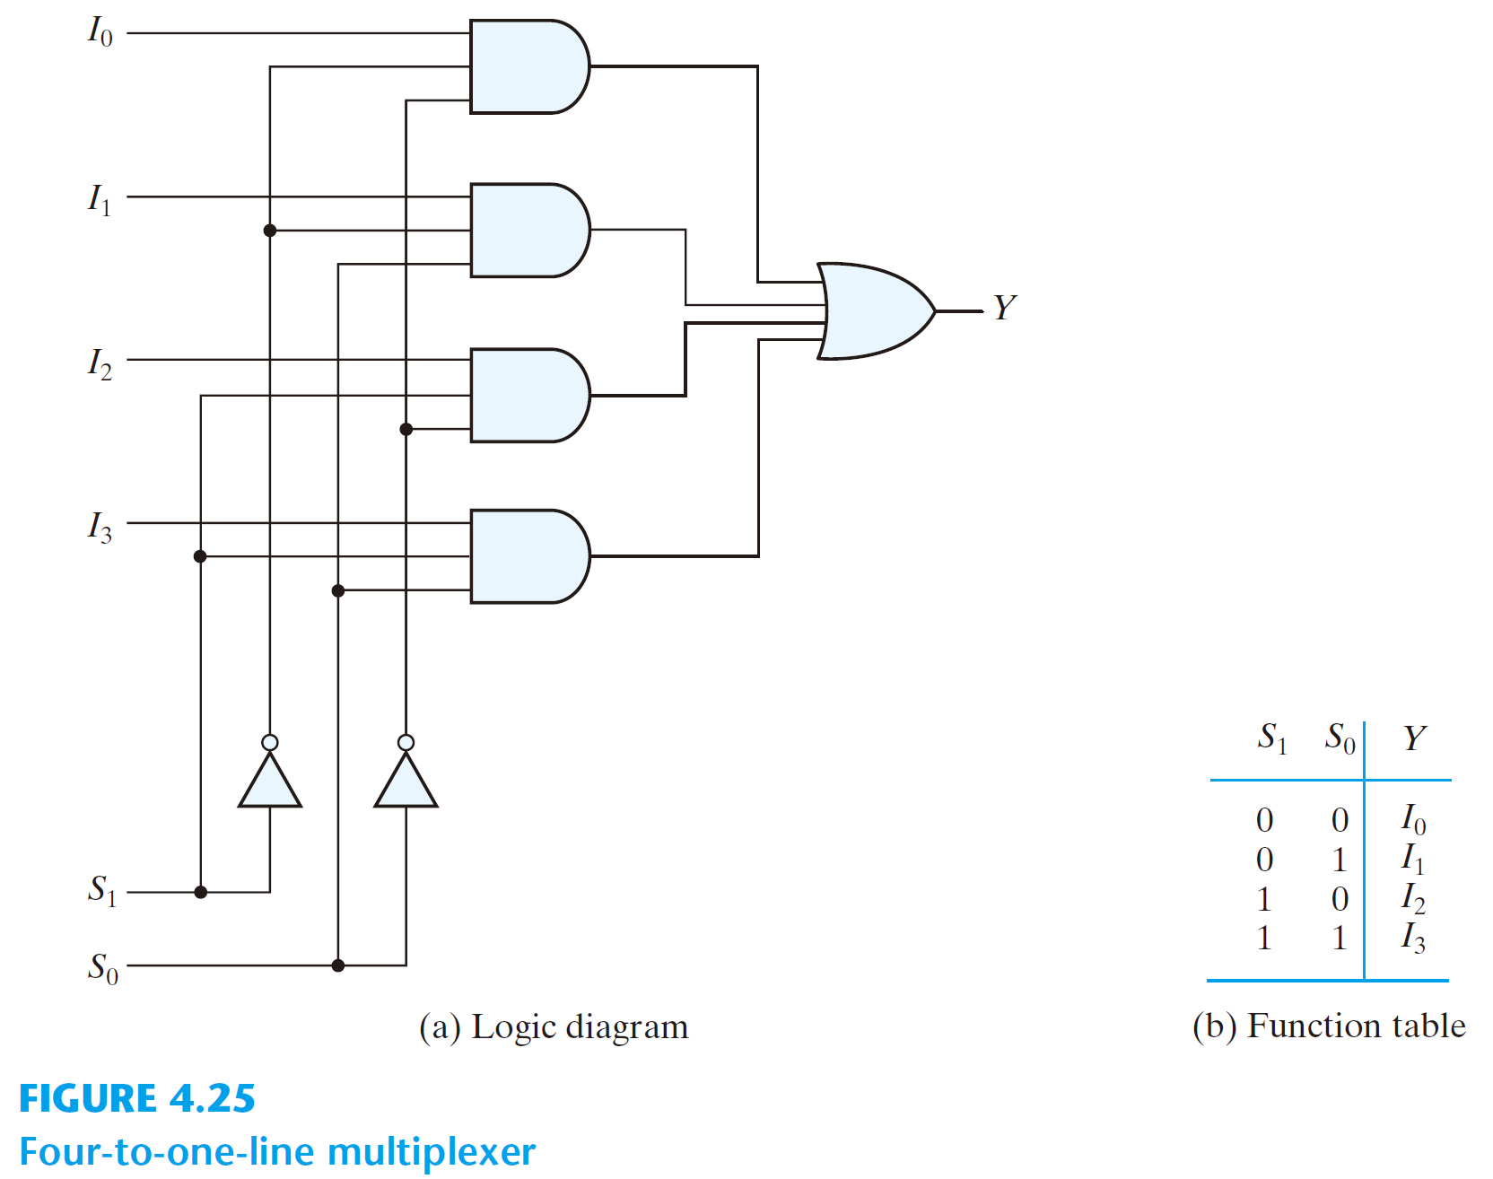
  4-to-1-line multiplexer
I₀
Y
I₁
I₂
I₃

Slide 75
  4-to-1-line multiplexer
I₀
Y
I₁
I₂
I₃
Y = S₁’S₀’I₀ + S₁’S₀I₁ + S₁S₀’I₂ + S₁S₀I₃

Slide 76
Y = S₁’S₀’I₀ + S₁’S₀I₁ + S₁S₀’I₂ + S₁S₀I₃

Slide 77
  MUX: a decoder + an OR gate
  2^{n}-to-1 MUX can implement any Boolean function of n input variable
  a better solution: implement any Boolean function of n+1 input variable
    n of these variables: the selection lines
    the remaining variable: the inputs

Slide 78
Procedure:
  assign an ordering sequence of the input variable
  the rightmost variable (D) will be used for the input lines
  assign the remaining n-1 variables to the selection lines w.r.t. their corresponding sequence
  construct the truth table
  consider a pair of consecutive minterms starting from m₀
  determine the input lines

Slide 79
  An example: F(x, y, z) = Σ(1, 2, 6, 7)
x | y | z | F
0 | 0 | 0 | 0
0 | 0 | 1 | 1
0 | 1 | 0 | 1
0 | 1 | 1 | 0
1 | 0 | 0 | 0
1 | 0 | 1 | 0
1 | 1 | 0 | 1
1 | 1 | 1 | 1

Slide 80
  An example: F(x, y, z) = Σ(1, 2, 6, 7)
x | y | z | F
0 | 0 | 0 | 0
0 | 0 | 1 | 1
0 | 1 | 0 | 1
0 | 1 | 1 | 0
1 | 0 | 0 | 0
1 | 0 | 1 | 0
1 | 1 | 0 | 1
1 | 1 | 1 | 1

Slide 81
  An example: F(x, y, z) = Σ(1, 2, 6, 7)
x | y | z | F
0 | 0 | 0 | 0
0 | 0 | 1 | 1
0 | 1 | 0 | 1
0 | 1 | 1 | 0
1 | 0 | 0 | 0
1 | 0 | 1 | 0
1 | 1 | 0 | 1
1 | 1 | 1 | 1

Slide 82
  An example: F(x, y, z) = Σ(1, 2, 6, 7)
x | y | z | F
0 | 0 | 0 | 0 | F = z
0 | 0 | 1 | 1
0 | 1 | 0 | 1
0 | 1 | 1 | 0
1 | 0 | 0 | 0
1 | 0 | 1 | 0
1 | 1 | 0 | 1
1 | 1 | 1 | 1

Slide 83
  An example: F(x, y, z) = Σ(1, 2, 6, 7)
x | y | z | F
0 | 0 | 0 | 0 | F = z
0 | 0 | 1 | 1
0 | 1 | 0 | 1
0 | 1 | 1 | 0
1 | 0 | 0 | 0
1 | 0 | 1 | 0
1 | 1 | 0 | 1
1 | 1 | 1 | 1

Slide 84
  An example: F(x, y, z) = Σ(1, 2, 6, 7)
x | y | z | F
0 | 0 | 0 | 0 | F = z
0 | 0 | 1 | 1
0 | 1 | 0 | 1 | F = z’
0 | 1 | 1 | 0
1 | 0 | 0 | 0
1 | 0 | 1 | 0
1 | 1 | 0 | 1
1 | 1 | 1 | 1

Slide 85
  An example: F(x, y, z) = Σ(1, 2, 6, 7)
x | y | z | F
0 | 0 | 0 | 0 | F = z
0 | 0 | 1 | 1
0 | 1 | 0 | 1 | F = z’
0 | 1 | 1 | 0
1 | 0 | 0 | 0 | F = 0
1 | 0 | 1 | 0
1 | 1 | 0 | 1
1 | 1 | 1 | 1

Slide 86
  An example: F(x, y, z) = Σ(1, 2, 6, 7)
x | y | z | F
0 | 0 | 0 | 0 | F = z
0 | 0 | 1 | 1
0 | 1 | 0 | 1 | F = z’
0 | 1 | 1 | 0
1 | 0 | 0 | 0 | F = 0
1 | 0 | 1 | 0
1 | 1 | 0 | 1 | F = 1
1 | 1 | 1 | 1

Slide 87
  An example: F(x, y, z) = Σ(1, 2, 6, 7)
x | y | z | F
0 | 0 | 0 | 0 | F = z
0 | 0 | 1 | 1
0 | 1 | 0 | 1 | F = z’
0 | 1 | 1 | 0
1 | 0 | 0 | 0 | F = 0
1 | 0 | 1 | 0
1 | 1 | 0 | 1 | F = 1
1 | 1 | 1 | 1

Slide 88
  An example: F(x, y, z) = Σ(1, 2, 6, 7)
x | y | z | F
0 | 0 | 0 | 0 | F = z
0 | 0 | 1 | 1
0 | 1 | 0 | 1 | F = z’
0 | 1 | 1 | 0
1 | 0 | 0 | 0 | F = 0
1 | 0 | 1 | 0
1 | 1 | 0 | 1 | F = 1
1 | 1 | 1 | 1
0
0
0
0
1

Slide 89
  An example: F(x, y, z) = Σ(1, 2, 6, 7)
x | y | z | F
0 | 0 | 0 | 0 | F = z
0 | 0 | 1 | 1
0 | 1 | 0 | 1 | F = z’
0 | 1 | 1 | 0
1 | 0 | 0 | 0 | F = 0
1 | 0 | 1 | 0
1 | 1 | 0 | 1 | F = 1
1 | 1 | 1 | 1
0
0
1
1
0

Slide 90
  An example: F(x, y, z) = Σ(1, 2, 6, 7)
x | y | z | F
0 | 0 | 0 | 0 | F = z
0 | 0 | 1 | 1
0 | 1 | 0 | 1 | F = z’
0 | 1 | 1 | 0
1 | 0 | 0 | 0 | F = 0
1 | 0 | 1 | 0
1 | 1 | 0 | 1 | F = 1
1 | 1 | 1 | 1
1
0
0
1
1

Slide 91
  An example: F(x, y, z) = Σ(1, 2, 6, 7)
x | y | z | F
0 | 0 | 0 | 0 | F = z
0 | 0 | 1 | 1
0 | 1 | 0 | 1 | F = z’
0 | 1 | 1 | 0
1 | 0 | 0 | 0 | F = 0
1 | 0 | 1 | 0
1 | 1 | 0 | 1 | F = 1
1 | 1 | 1 | 1
1
0
1
0
0

Slide 92
  An example: F(x, y, z) = Σ(1, 2, 6, 7)
x | y | z | F
0 | 0 | 0 | 0 | F = z
0 | 0 | 1 | 1
0 | 1 | 0 | 1 | F = z’
0 | 1 | 1 | 0
1 | 0 | 0 | 0 | F = 0
1 | 0 | 1 | 0
1 | 1 | 0 | 1 | F = 1
1 | 1 | 1 | 1
0
1
0
0
1

Slide 93
  An example: F(x, y, z) = Σ(1, 2, 6, 7)
x | y | z | F
0 | 0 | 0 | 0 | F = z
0 | 0 | 1 | 1
0 | 1 | 0 | 1 | F = z’
0 | 1 | 1 | 0
1 | 0 | 0 | 0 | F = 0
1 | 0 | 1 | 0
1 | 1 | 0 | 1 | F = 1
1 | 1 | 1 | 1
0
1
1
0
0

Slide 94
  An example: F(x, y, z) = Σ(1, 2, 6, 7)
x | y | z | F
0 | 0 | 0 | 0 | F = z
0 | 0 | 1 | 1
0 | 1 | 0 | 1 | F = z’
0 | 1 | 1 | 0
1 | 0 | 0 | 0 | F = 0
1 | 0 | 1 | 0
1 | 1 | 0 | 1 | F = 1
1 | 1 | 1 | 1
1
1
0
1
1

Slide 95
  An example: F(x, y, z) = Σ(1, 2, 6, 7)
x | y | z | F
0 | 0 | 0 | 0 | F = z
0 | 0 | 1 | 1
0 | 1 | 0 | 1 | F = z’
0 | 1 | 1 | 0
1 | 0 | 0 | 0 | F = 0
1 | 0 | 1 | 0
1 | 1 | 0 | 1 | F = 1
1 | 1 | 1 | 1
1
1
1
1
0

Slide 96
Example: F(A, B, C, D) = Σ(1, 3, 4, 11, 12, 13, 14, 15)

Slide 97
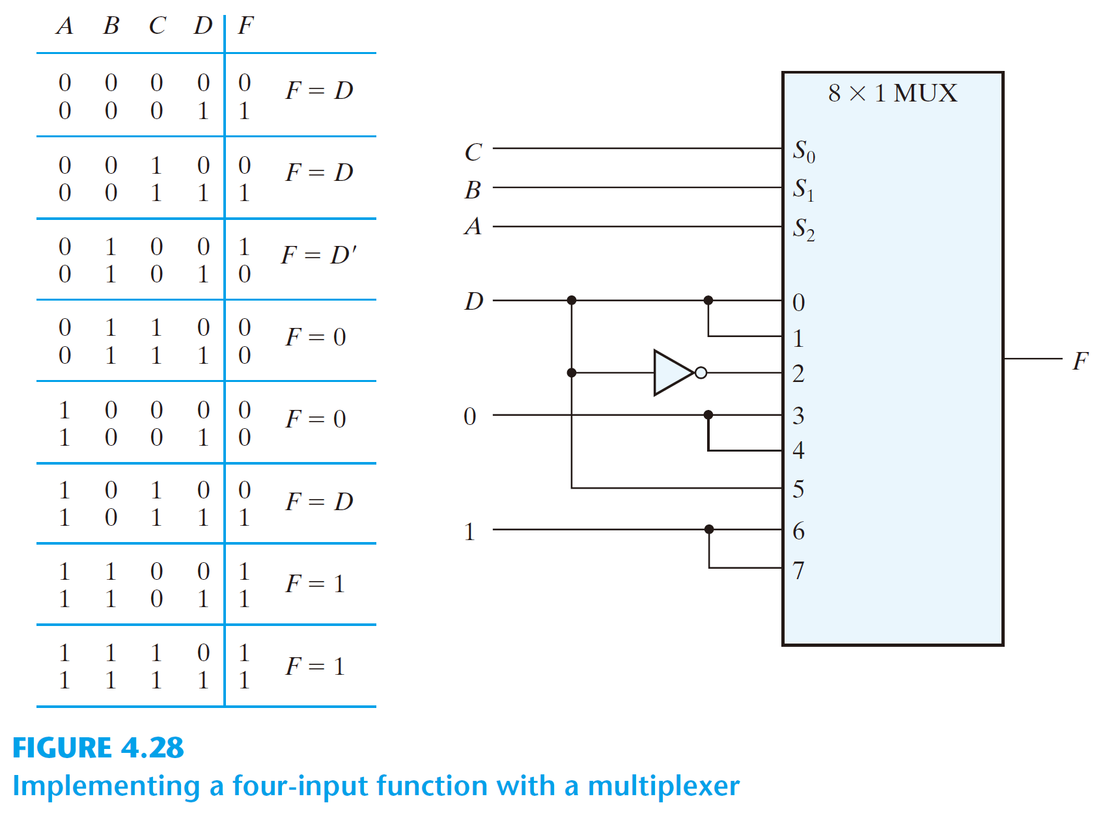
Example: F(A, B, C, D) = Σ(1, 3, 4, 11, 12, 13, 14, 15)

Slide 98
Example: F(A, B, C, D) = Σ(1, 3, 4, 11, 12, 13, 14, 15)

Slide 99
Example: F(A, B, C, D) = Σ(1, 3, 4, 11, 12, 13, 14, 15)

Slide 100
Example: F(A, B, C, D) = Σ(1, 3, 4, 11, 12, 13, 14, 15)

Slide 101
Example: F(A, B, C, D) = Σ(1, 3, 4, 11, 12, 13, 14, 15)

Slide 102
Example: F(A, B, C, D) = Σ(1, 3, 4, 11, 12, 13, 14, 15)

Slide 103
Example: F(A, B, C, D) = Σ(1, 3, 4, 11, 12, 13, 14, 15)

Slide 104
Example: F(A, B, C, D) = Σ(1, 3, 4, 11, 12, 13, 14, 15)

Slide 105
Example: F(A, B, C, D) = Σ(1, 3, 4, 11, 12, 13, 14, 15)

Slide 106
Example: F(A, B, C, D) = Σ(1, 3, 4, 11, 12, 13, 14, 15)

Slide 107
Example: F(A, B, C, D) = Σ(1, 3, 4, 11, 12, 13, 14, 15)

Slide 108
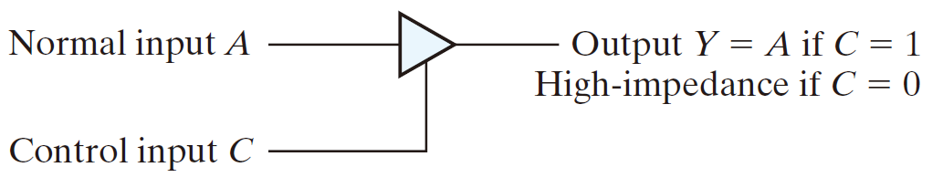
  A multiplexer can be constructed with three-state gates
  Output state: 0, 1, and high-impedance (open circuits)

Slide 109
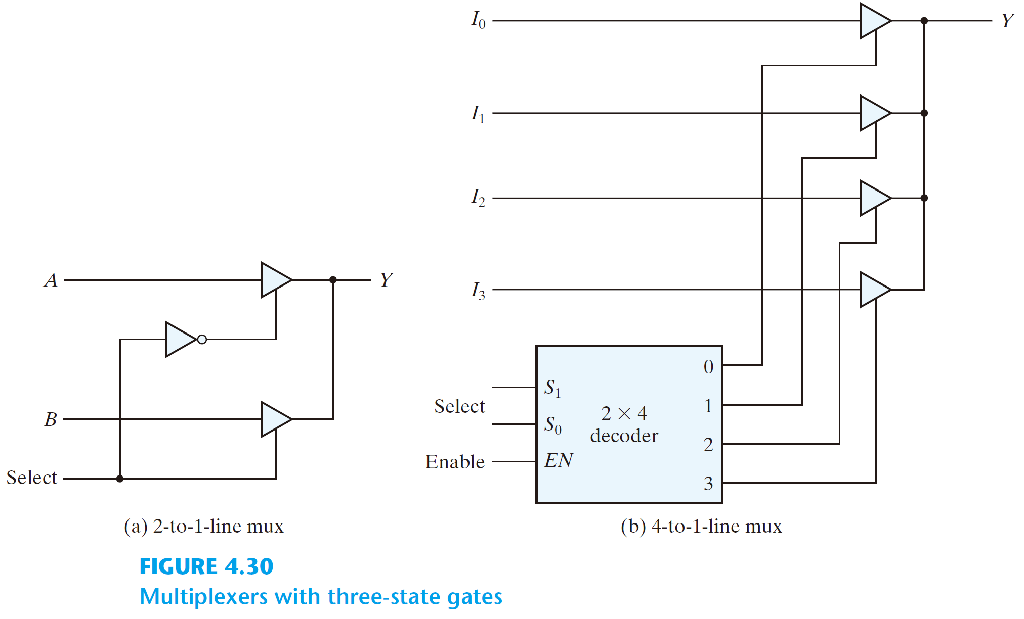
2-to-1 Multiplexer
0

Slide 110
2-to-1 Multiplexer
1
0
0

Slide 111
2-to-1 Multiplexer
1
X
0
0

Slide 112
2-to-1 Multiplexer
Y = A
1
X
0
0

Slide 113
2-to-1 Multiplexer
1

Slide 114
2-to-1 Multiplexer
0
1
1

Slide 115
2-to-1 Multiplexer
X
0
1
1

Slide 116
2-to-1 Multiplexer
X
Y = B
0
1
1

Slide 117
4-to-1 Multiplexer

Slide 118
4-to-1 Multiplexer
0

Slide 119
4-to-1 Multiplexer
X
0
X
0
X
0
X
0
0

Slide 120
4-to-1 Multiplexer
X
0
Y =
High-Impedance
X
0
X
0
X
0
0

Slide 121
4-to-1 Multiplexer
1
X
0
X
0
X
0
0
0
1

Slide 122
4-to-1 Multiplexer
Y = I₀
1
X
0
X
0
X
0
0
0
1

Slide 123
4-to-1 Multiplexer
X
Y = I₁
0
1
X
0
X
0
0
1
1

Slide 124
4-to-1 Multiplexer
X
Y = I₂
0
X
0
1
X
0
1
0
1

Slide 125
4-to-1 Multiplexer
X
Y = I₃
0
X
0
X
0
1
1
1
1

Slide 126
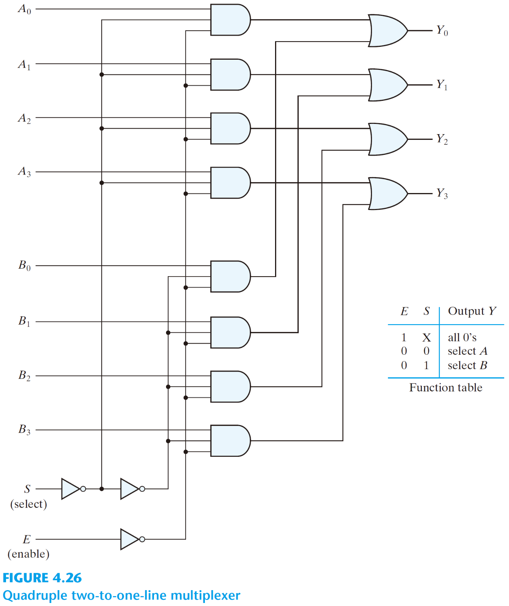
Quadruple
2-to-1 Multiplexer
E | S | Y
0 | X | 0
1 | 0 | A
1 | 1 | B

Slide 127
Quadruple
2-to-1 Multiplexer
E | S | Y
0 | X | 0
1 | 0 | A
1 | 1 | B
0

Slide 128
Quadruple
2-to-1 Multiplexer
0
0
0
0
E | S | Y
0 | X | 0
1 | 0 | A
1 | 1 | B
0

Slide 129
Quadruple
2-to-1 Multiplexer
Y = A
1
E | S | Y
0 | X | 0
1 | 0 | A
1 | 1 | B
0
0
1

Slide 130
Quadruple
2-to-1 Multiplexer
Y = B
0
E | S | Y
0 | X | 0
1 | 0 | A
1 | 1 | B
1
1
1

